Slide 1


Serverless AI Inference API using AWS SageMaker and Streamlit
Supervised by Prof. Dr. Osama Amjad
Wael Fahmy 1265745
Amirhossein Zeinali Dehaghani 1225496
COMP-5411-AA – Cloud Computing for AI and ML

Slide 2

Introduction
Deploying ML models is often limited by cost, complexity, and scalability
Traditional VMs and containers require ongoing maintenance
This project uses AWS serverless tools to build a scalable, cost-effective inference pipeline
Enables real-time sentiment classification via a user-friendly web app

Slide 3
Background And Related Work
Serverless computing offers low-latency, scalable ML workflows with reduced operational overhead.
Prior studies focused on backend orchestration or infrastructure, overlooking usability and interactivity.
Existing work lacked a fully integrated, user-facing frontend for real-time ML inference.
Our solution delivers an end-to-end pipeline with serverless backend, secured API, and an intuitive Streamlit interface.

Slide 4
Literature Review
Serverless ML solutions offer on-demand computation without infrastructure management.
Key studies guided our design, covering orchestration, cold-start optimization, platform selection, batch inference, and CI/CD workflows.
Additional research informed our monitoring, scalability, latency optimization, and performance trade-off strategies.
Our contribution advances prior work with a full end-to-end system: real-time inference, automation, monitoring, and a user-friendly Streamlit frontend.

Slide 5
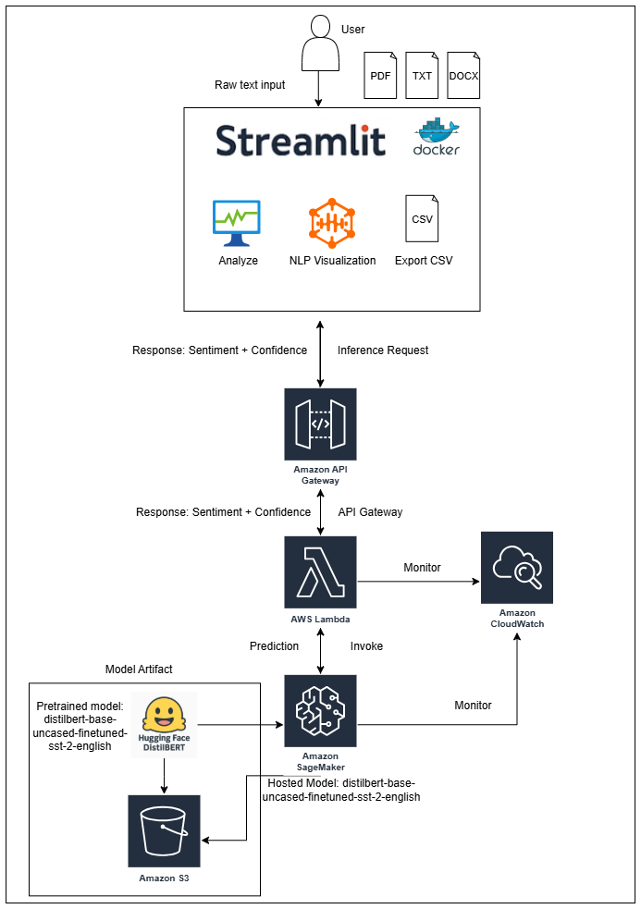

System Architecture
AWS SageMaker: Model hosting (DistilBERT)
AWS Lambda: Backend inference handler
API Gateway: RESTful API layer
IAM & S3: Secure storage and access
Streamlit: No-code frontend UI
NLP: Word Cloud and Heatmap
CloudWatch: Monitoring and logging

Slide 6
Implementation Steps
Download and package Hugging Face model
Configure IAM roles and upload to S3
Deploy model to SageMaker
Create Lambda function to invoke endpoint
Expose via API Gateway
Build Streamlit frontend, NLP Analysis and Dockerization
Monitor with CloudWatch

Slide 7
Streamlit Frontend
Sentence/paragraph/file-level sentiment analysis
Word cloud and heatmap visualizations
CSV export of results
Responsive web interface for desktop/mobile
Real-time feedback from deployed model

Slide 8
Demo Access and Code
Streamlit App
GitHub Repository
https://cloud-computing-ai-inference.streamlit.app/
https://github.com/wael-fahmy/sentiment-streamlit
Includes: model deployment scripts, Lambda handler, Streamlit UI

Slide 9

Validation and Results
Inference time < 1s for all inputs
High accuracy using DistilBERT
CloudWatch: Monitored latency, errors, endpoint status
No errors observed in Lambda/API Gateway/SageMaker
9

Slide 10
Critical Analysis & Limitations
Cold start latency
No GPU support
English-only model

Slide 11
Future Work
Multilingual support
(mBERT, XLM-R)
Cognito login integration
Multi-model routing and batch inference

Slide 12
Conclusion
Demonstrated a full serverless pipeline for real-time NLP inference
Minimal infrastructure management using AWS native tools
Scalable, cost-effective, and accessible to end users
Foundation for future serverless ML applications

